Slide 1
Decision Making, Branching
Switch and Break (Cont..)

Slide 2
Problem: Find the roots of Quadratic equation using switch statement
#include<stdio.h>
int main()
{
Int d;
float a,b,c,root1,root2,re,im, disc;
printf(“Enter the values of a, b & c:“);
scanf(“%f %f %f”,&a,&b,&c);
disc=b*b-4*a*c;
printf("\nDiscriminant= %f“,disc);
if(disc<0) d=1;
if(disc==0) d=2;
if(disc>0) d=3;
switch(d)
{
case 1:
printf("imaginary roots\n“);
re= - b / (2*a);
im = pow(fabs(disc),0.5)/(2*a);
printf(“root1=%.21f+%.21fi and root2 =%.21f-%.2fi”, re,im,re,im); break;

Slide 3
case 2:
printf(“Real & equal roots“);
re=-b / (2*a);
printf(“Root1 and root2 are %.21f”,re);
break;
case 3: printf(“Real & distinct roots“);
printf(“Roots are“);
root1=(-b + sqrt(disc))/(2*a);
root2=(-b - sqrt(disc))/(2*a);
printf(“Root1 = %.21f and root2 =%.21f”,root1,root2); break;
} // end of switch
return 0;
} //End of Program

Slide 4
Some guidelines for writing switch case statements
Order the cases alphabetically or numerically – improves readability. Put the normal cases first ; put the exceptional cases later. Order cases by frequency:-put the most frequently executed cases first and the least frequently used cases later. Use default case to detect errors and unexpected cases [user friendly messages].

Slide 5
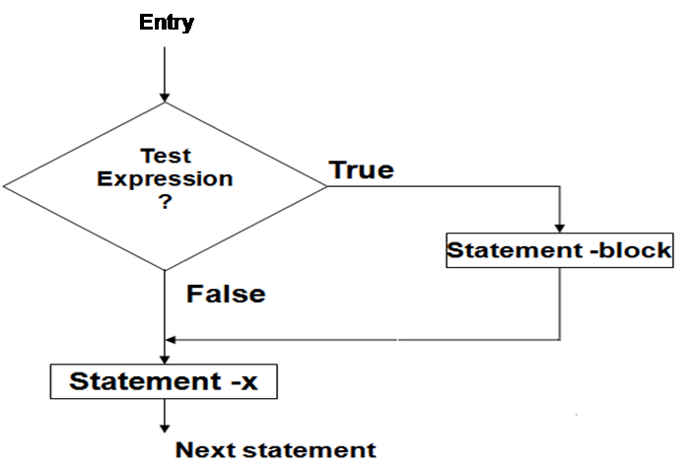
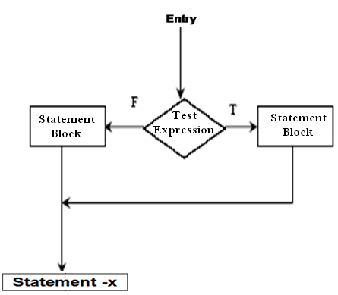
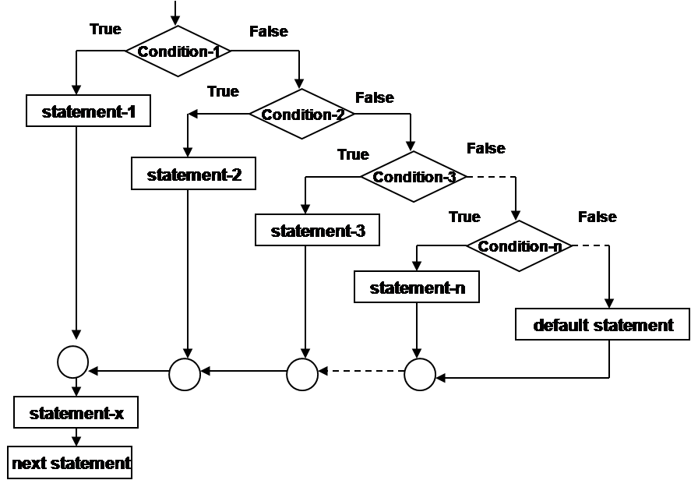
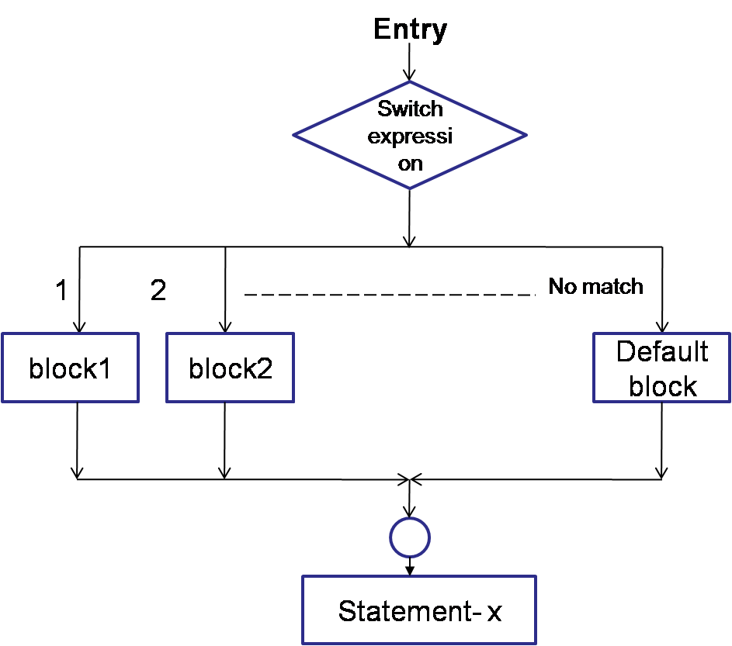
Flow of control in various control structures

